Slide 1
Subtitle Generator and Summarizer
Python | MoviePy | Whisper | Transformers | PyTorch | JiWER | ROUGE | NLTK | OS
Reshma Pandit

Slide 2
🚨 Problem
⏱️ Students don’t have time to watch full lectures
🌐 Lack of subtitles reduces accessibility
📄 No quick summaries for revision
🎥 Large volume of lecture content
🎯 Goals
🎧 Convert video lectures into audio
📝 Generate accurate transcripts & subtitles
✂️ Create short and clear summaries
✅ Improve accessibility and quick learning

Slide 3
Agenda
l
Project Overview
Problem Statement & Objectives
System Architecture & Workflow
Audio Extraction & Transcription
Subtitle Generation & Summarization
Evaluation Metrics & Results
Conclusion & Future Scope

Slide 4
Tools & Technologies
Python – Core programming language
OpenAI Whisper – Speech-to-text transcription
BART / FLAN-T5 – Text summarization and grammar correction
yt-dlp & MoviePy – Video downloading and audio extraction
jiwer & ROUGE – Evaluation metrics for transcription and summary
Jupyter Notebook – Development and testing environment

Slide 5
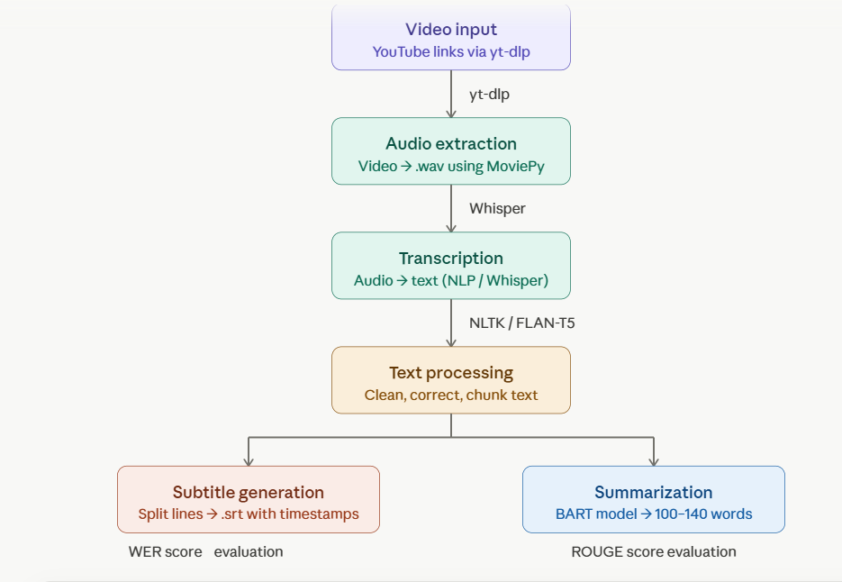
Workflow Diagram
Load YouTube lecture video links
Extract audio (.wav) from video using yt-dlp
Convert audio to text using Whisper model
Clean and correct transcript text
Split text into lines and generate .srt subtitles
Summarize transcript using BART model
Evaluate using WER and ROUGE scores

Slide 6
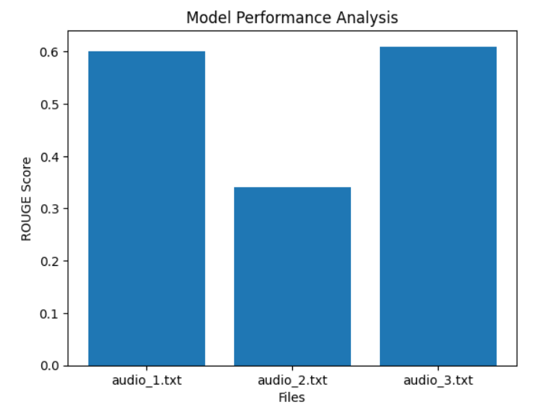
Visualization

Slide 7
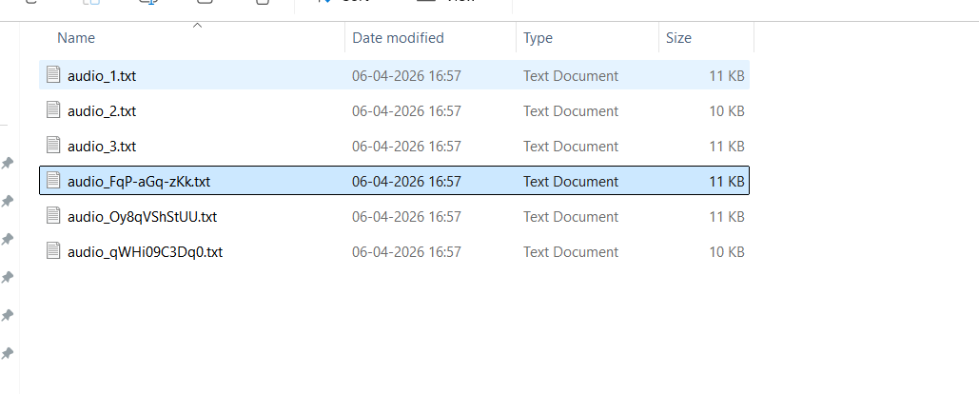
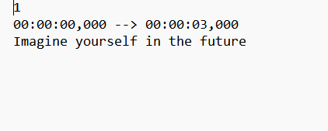
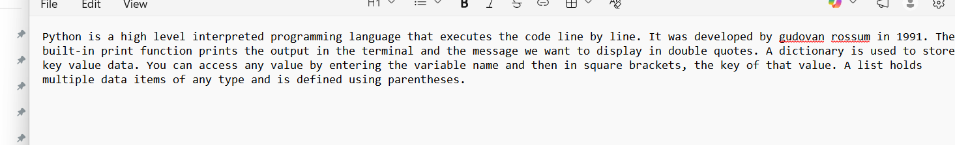
NLP-Based Subtitle Generator & Summarizer for Lecture Videos
Transcript Output
Subtitle .srt File
Summary Output

Slide 8
✅ Conclusion
Successfully built an end-to-end NLP pipeline to convert lecture videos into subtitles and summaries
Whisper model accurately transcribed audio to text and BART generated concise 100–140 word summaries
Evaluated model performance using WER and ROUGE scores to ensure quality output
Improved student accessibility and reduced revision time for edtech platforms
📚 Learnings
Gained hands-on experience with NLP models like Whisper, BART and HuggingFace Transformers
Learned speech-to-text transcription, text cleaning and subtitle generation in a real project
Understood how to evaluate NLP models using WER and ROUGE metrics
Built confidence in developing a complete AI pipeline from video input to final output

Slide 9
Questions ?

Slide 10
Thank You!

